Slide 2
Cross-Platform Native User Interfaces with Xamarin.Forms
Presenter Name
Presenter Twitter
Presenter Title

Slide 3
Meet Xamarin.Forms
Build native UIs for iOS, Android, and Windows
from a single, shared C# codebase.

Slide 4

Xamarin + Xamarin.Forms
iOS C# UI
Android C# UI
Windows C# UI
Shared UI Code
Shared C# Backend
Shared C# Backend
Traditional Xamarin Approach
With Xamarin.Forms: More code-sharing, all native

Slide 5
What’s included
✓ 40+ Pages, layouts, and controls
(Build from code behind or XAML)
✓ Two-way data binding
✓ Navigation
✓ Animation API
✓ Dependency Service
✓ Messaging Center
Shared UI Code
Shared C# Backend

Slide 6

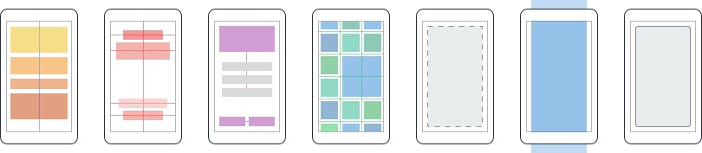
Layouts
Pages
Content
MasterDetail
Navigation
Tabbed
Carousel
Stack
Absolute
Relative
Grid
ContentView
ScrollView
Frame
Notes:
Inside of a page are layouts
A lot of options from something simple like a stack panel to complex and powerful grids

Slide 7
Controls
ActivityIndicator
BoxView
Button
DatePicker
Editor
Entry
Image
Label
ListView
Map
OpenGLView
Picker
ProgressBar
SearchBar
Slider
Stepper
TableView
TimePicker
WebView
EntryCell
ImageCell
SwitchCell
TextCell
ViewCell
Notes:
You have more than 40 controls, layouts, and pages to mix and match from.
These are all of the controls you have out of the box, you can of course create your own.
What is unique is you get the native control and have access to it.
Consider an Entry Field
On iOS it is mapped to UITextField
Android it is EditText
Windows Phoen it is a TextBox

Slide 8


Xamarin.Forms Ecosystem

Slide 9
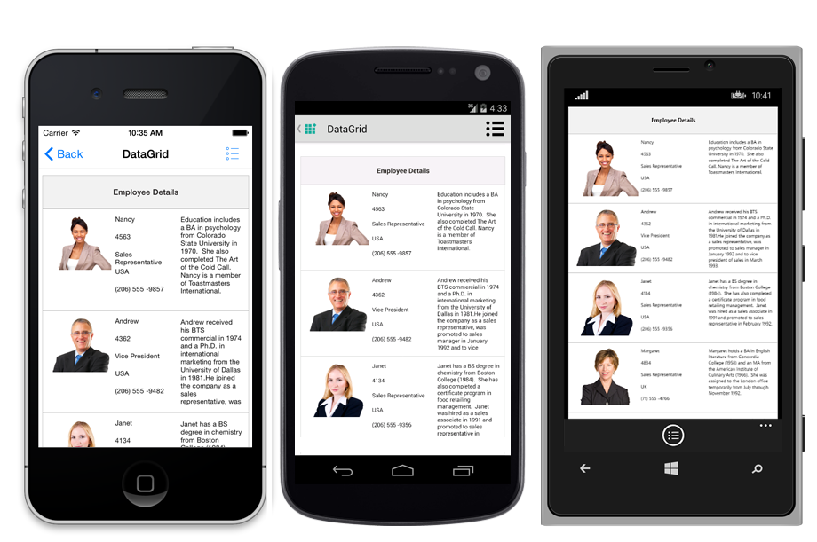
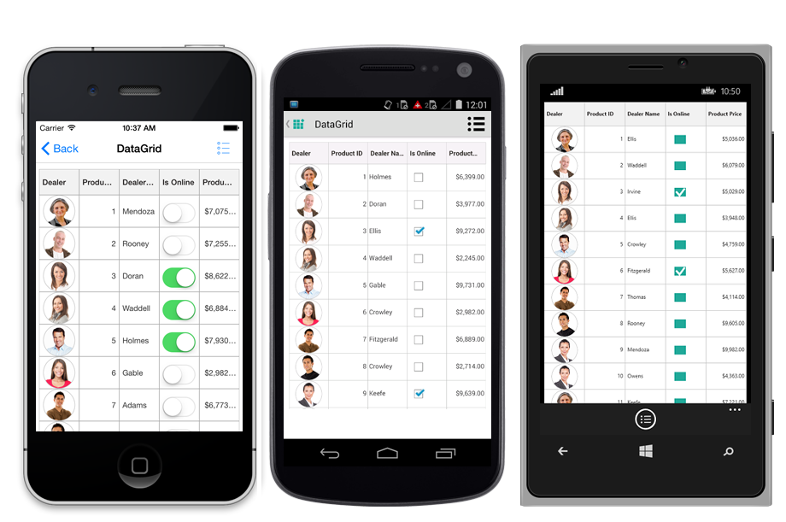
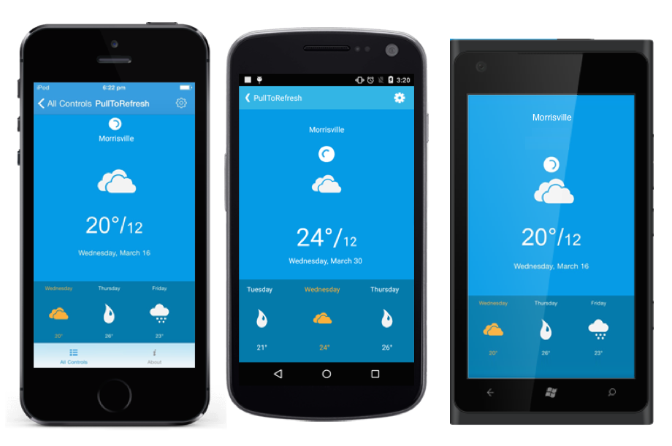
Syncfusion Essential Studio for Xamarin
Free Community License
Stunning data visualization components
Unique Excel, Word, and PDF manipulations
Traditional iOS & Android
Full Xamarin.Forms Support
iOS, Android, and Windows
C# or XAML
Data Binding Support
syncfusion.com/products/xamarin

Slide 10


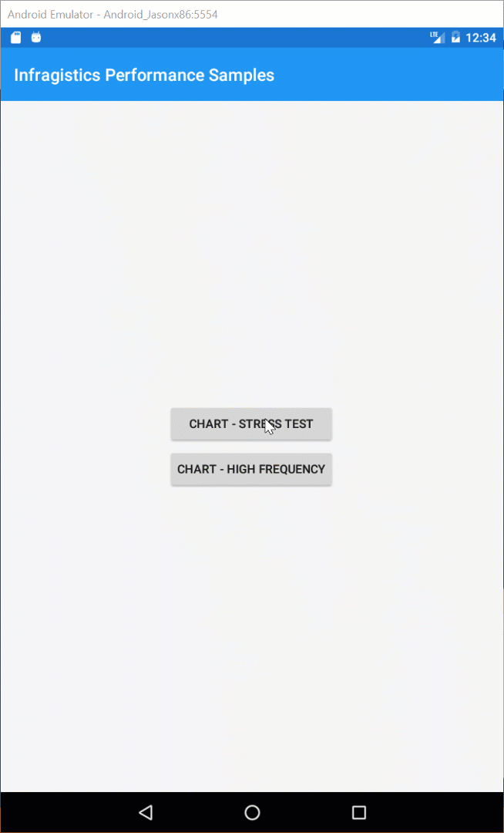

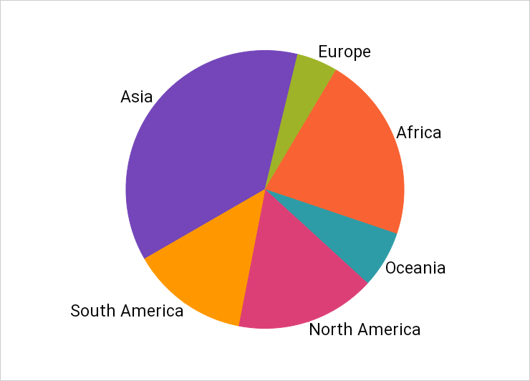
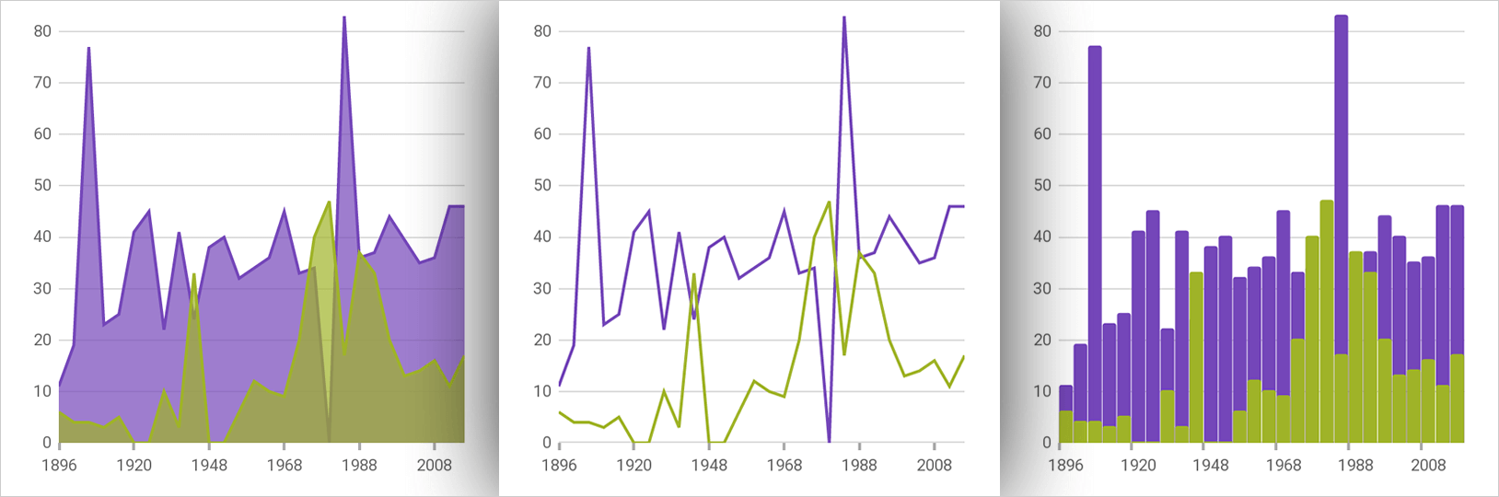

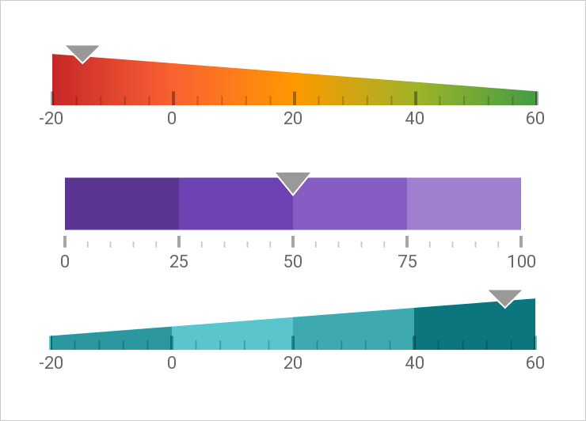
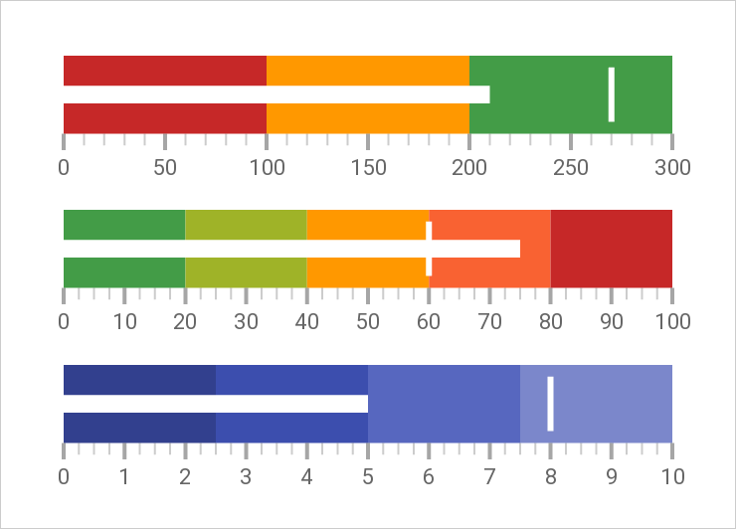
Infragistics Ultimate UI for Xamarin
The complete toolkit for building fast, beautiful, native mobile apps
Lightning-fast UI controls
Data grids gracefully render even the heaviest data loads
Data charts that handle millions of data points with millisecond refresh rates
Revolutionary WYSIWYG design tools for Xamarin.Forms
Free trial: www.infragistics.com/xamarin

Slide 11

Telerik UI for Xamarin
Polished UI controls out of the box
Allows developers to focus on app features, rather sweating UI details
Native controls for Xamarin.iOS & Xamarin.Android
Cross-platform wrappers for Xamarin.Forms
Extreme performance tuned
Works seamlessly on Windows/Mac
Easy integration through NuGet and Templates
Lot of customization options
Sample apps in Stores
The Best .NET UI for .NET Ninjas!
telerik.com/xamarin-ui

Slide 12
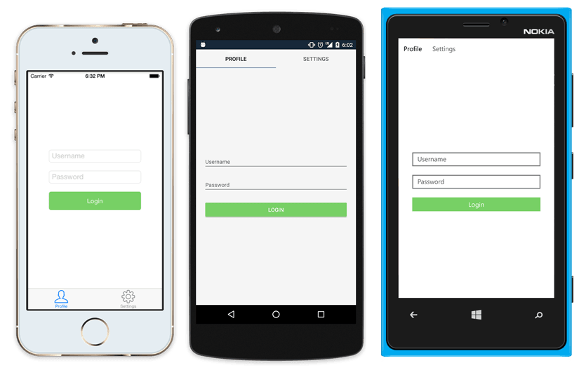
Native UI from shared code
<?xml version="1.0" encoding="UTF-8"?>
<TabbedPage xmlns="http://xamarin.com/schemas/2014/forms"
xmlns:x="http://schemas.microsoft.com/winfx/2009/xaml"
x:Class="MyApp.MainPage">
<TabbedPage.Children>
<ContentPage Title="Profile" Icon="Profile.png">
<StackLayout Spacing="20" Padding="20"
VerticalOptions="Center">
<Entry Placeholder="Username"
Text="{Binding Username}"/>
<Entry Placeholder="Password"
Text="{Binding Password}"
IsPassword="true"/>
<Button Text="Login" TextColor="White"
BackgroundColor="#77D065"
Command="{Binding LoginCommand}"/>
</StackLayout>
</ContentPage>
<ContentPage Title="Settings" Icon="Settings.png">
<!-- Settings -->
</ContentPage>
</TabbedPage.Children>
</TabbedPage>

Slide 13
Xamarin.Forms Demo

Slide 14
Latest and Greatest in Xamarin.Forms

Slide 15
Xamarin.Forms 1 Year of Open Source!
Notes:
Can you believe it? It has been 1 year since Xamarin.Forms was opened sourced! And what a year!

Slide 16
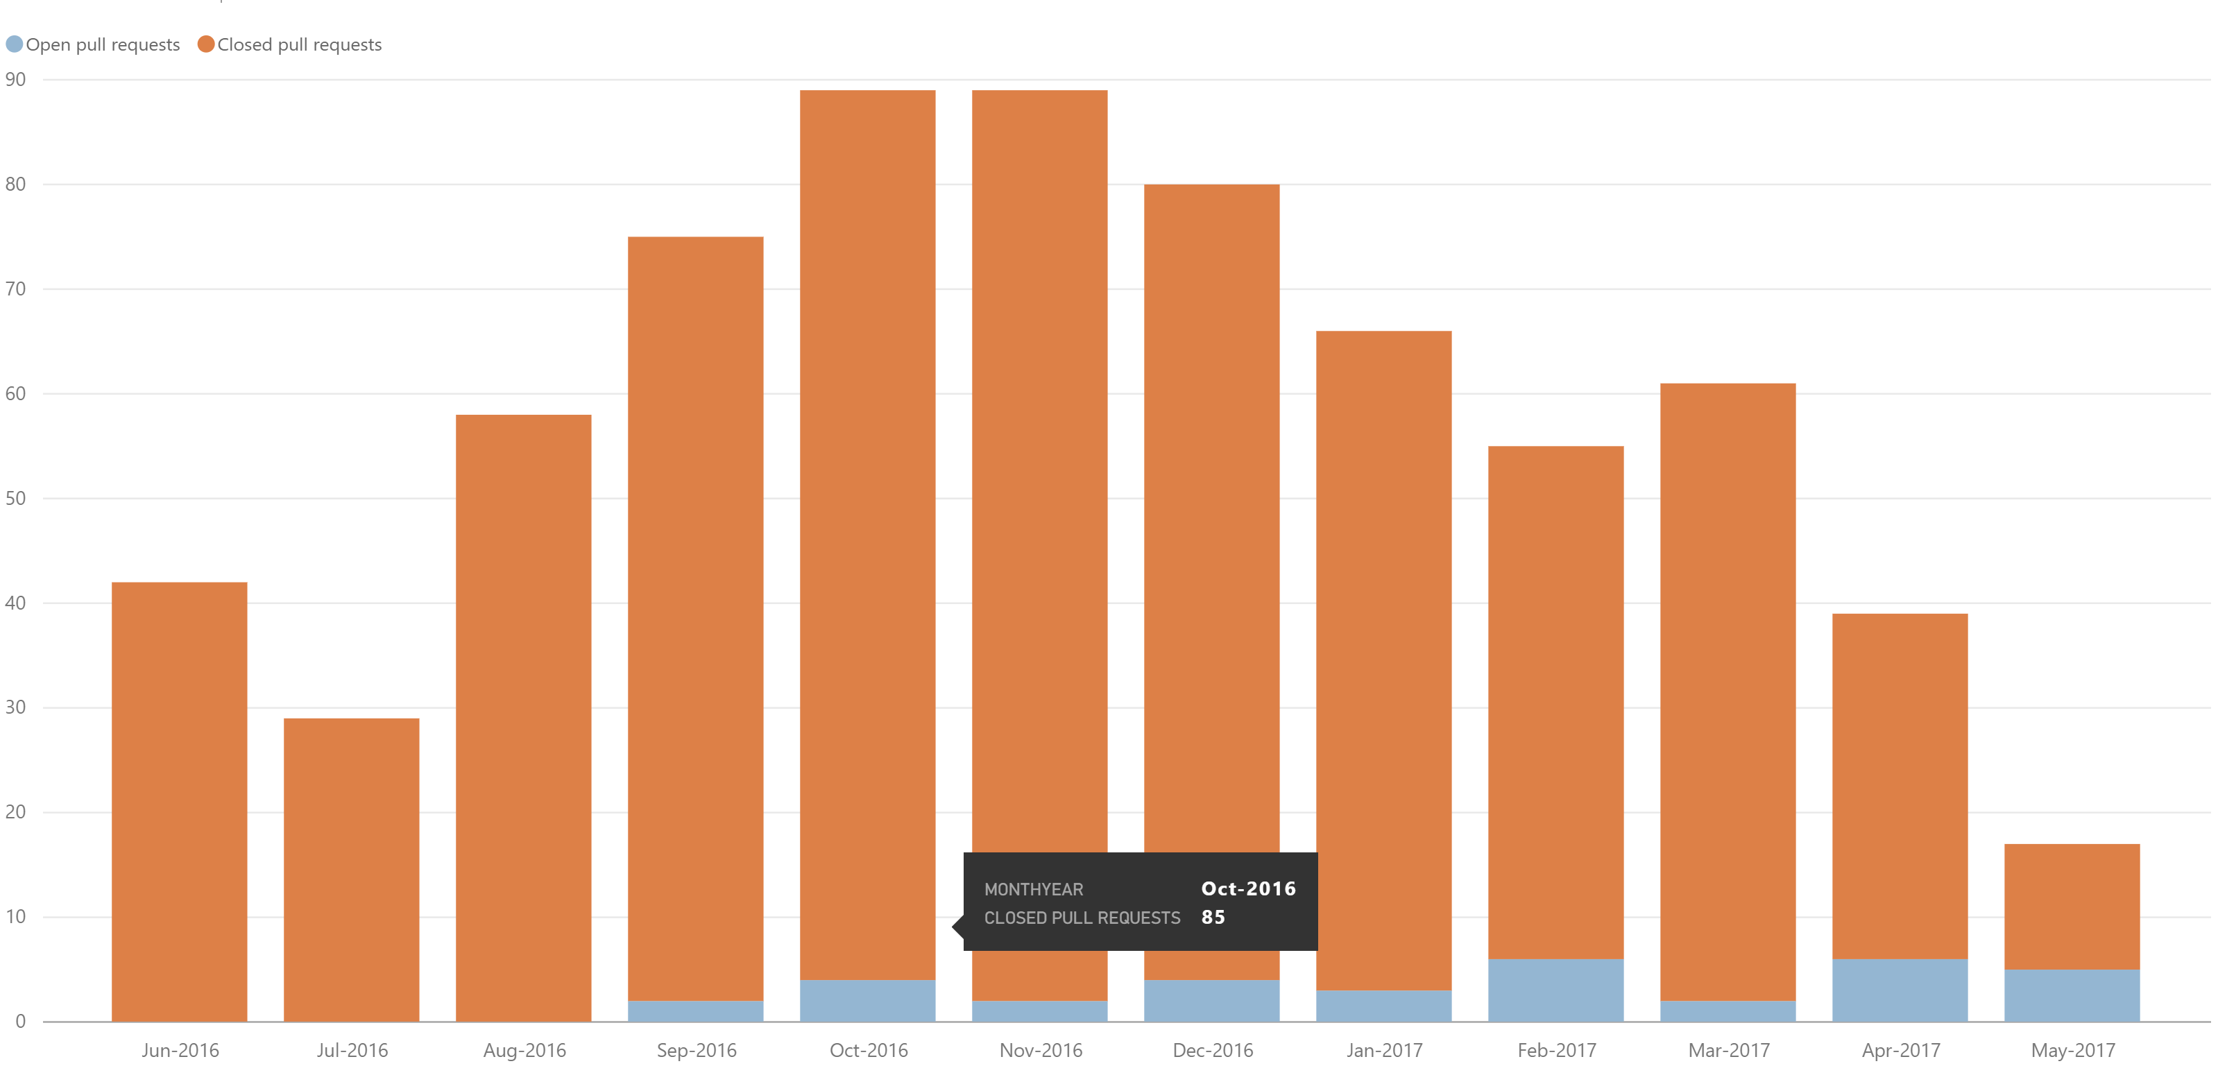
Community
Public Roadmap: aka.ms/xfroadmap
70 contributors
700 merged pull requests
37 evolution proposals
Notes:
We have created a full public roadmap and crafting it with your help.
Tons of merged PRs and tons of contributors! We love it!

Slide 17
Features and Enhancements
Fast Renderers Preview
Memory Improvements
Native Control Binding
Bindable Picker
Map Extensibility
Startup Time
XAMLC
Forms Previewer
Android Support Libraries
FlexLayout Preview
Frame Corners
Enhanced GestureRecognizers
Tizen
Blur Behind
macOS Preview
Themes
ListView Scrolling
Embedded Native Controls
Deep Linking
.netstandard support
Styles
Fast Scroll
Xamarin.Forms Embedding
NavigationPage Translucency
Accessibility
PlatformSpecifics
Partial Collapse MasterPage
DataPages
Notes:
We have also added a plethora of amazing new features!

Slide 18

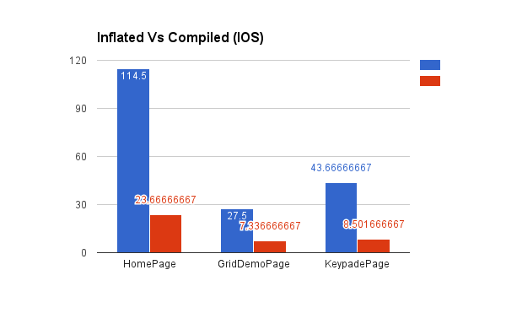
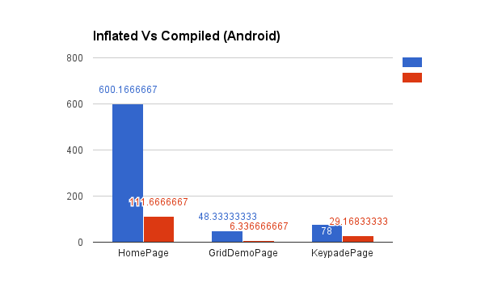
Quality and Performance
Aggressive bug triage
New issues reviewed within 24 hrs
Reproduction projects for quick resolution
Performance Improvements
Startup Time
Fast Renderers for Android
ListView improvements, Fast Scroll
XAMLC – 5x faster
Discussion: aka.ms/xfperformance
Source: Matthew Robbins - MFractor

Slide 19
The Future: Xamarin.Forms 3.0
Notes:
On the horizon of course is 3.0! With great new features

Slide 20
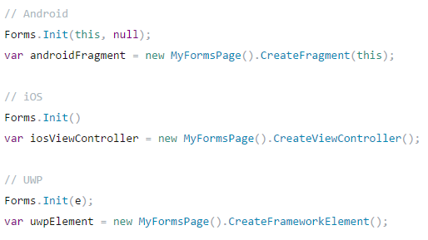
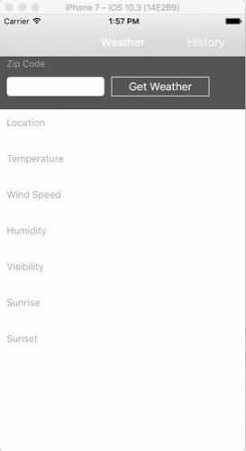
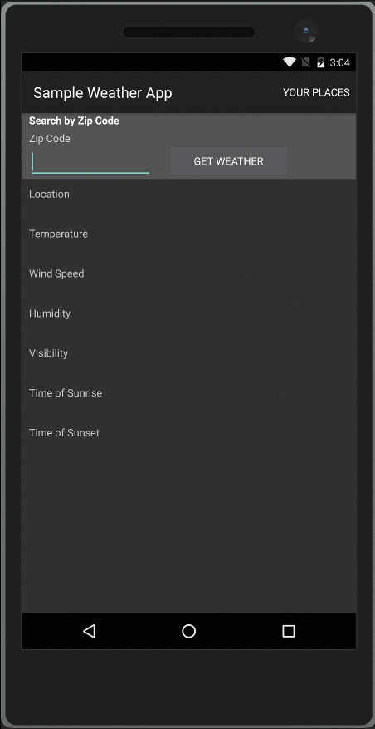
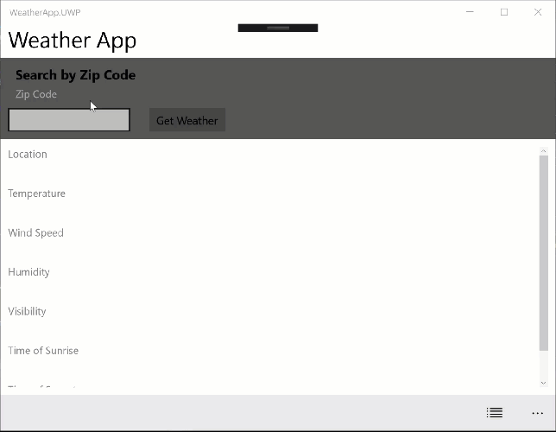
Xamarin.Forms Embedding
Easily embed any page into a Xamarin Native Application

Slide 21
Embedding
Works on ContentPages
Full support for DependencyService and MessagingCenter
Xamarin.Forms
Android Java
iOS
Obj-C
Swift
iOS C#
Android C#
Windows C#
?
Shared C# Logic
Notes:
Xamarin.Forms embedding is the future!

Slide 22
FlexLayout
A CSS FlexBox inspired layout system
Used for
Flowing items
Adaptive layout
Notes:
Ask audience if they know what flexbox is
Ask audience if they LIKE flexbox

Slide 23
FlexLayout Example
<?xml version="1.0" encoding="UTF-8"?>
<ContentPage xmlns="http://xamarin.com/schemas/2014/forms"
xmlns:x=http://schemas.microsoft.com/winfx/2009/xaml
x:Class="FormsFlexLayoutDemo.FlexDemoPage">
<FlexLayout x:Name="flexbox”>
<Label Text="Flex Element 1" />
<Label Text="Flex Element 2" />
<Label Text="Flex Element 3" />
<Label Text="Flex Element 4" />
<Label Text="Flex Element 5" />
</FlexLayout>
</ContentPage>
Flex Element 1
Flex Element 2
Flex Element 3
Flex Element 4
Flex Element 5

Slide 24

New Platforms
Samsung Tizen
Televisions, Wearables, Mobile
macOS
WPF
Linux: GTK#
Notes:
At the end of talking through this, I’ll do a quick intro of Jason and call him up to demo.

Slide 25
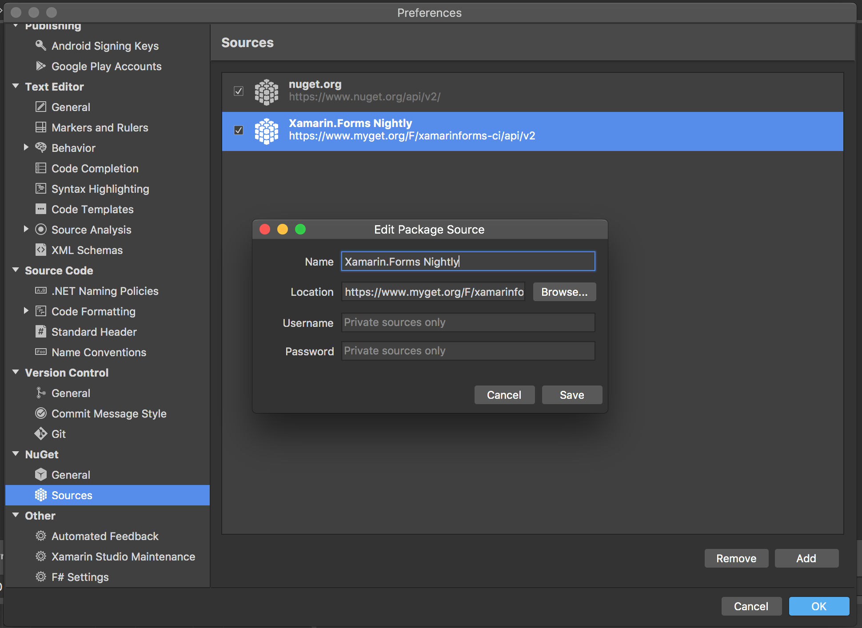
Nightly Builds
https://github.com/xamarin/Xamarin.Forms/wiki/Nightly-Builds

Slide 26
One More Thing: Getting Started Faster

Slide 27

Xamarin Live Player
Continuously deploy & debug apps
Notes:
When you want to get started you may not want to worry about emulators, sdks, and all the other over head of getting an app running. This is where the new Xamarin Live Player comes in, enabling you to continuously deploy, debug, and real time code your iOS and Android apps.

Slide 28
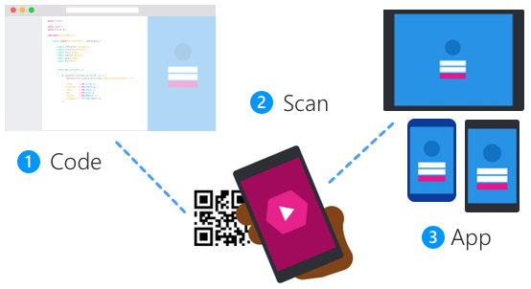
Xamarin Live Player Setup
Notes:
All you do is create your code base, pair your device, and run your app! That is it from with VS Mac or VS 2017. Here is what it looks like in action.

Slide 29
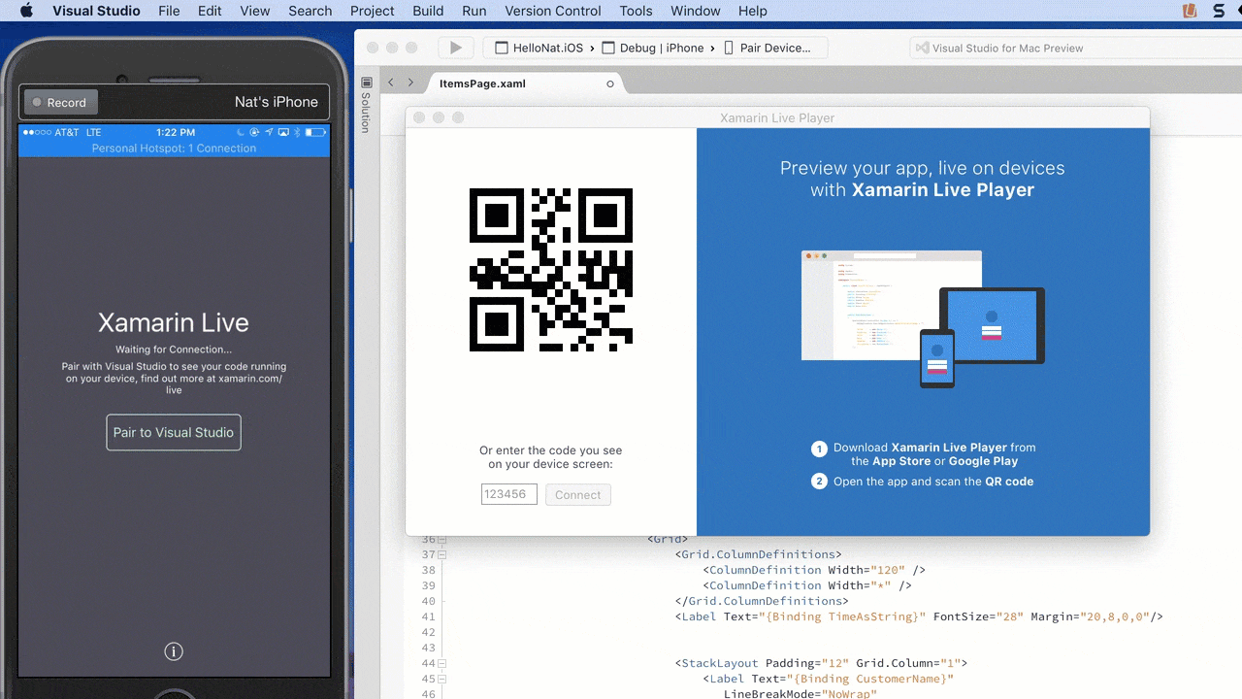
Notes:
Just like that you can debug your app or “live run current view” and modify and update your UI in real time.

Slide 30
15 Minute Break
Presenter First Name
Presenter Last Name
Presenter Title
Presenter e-mail
blogs
Twitter

